Slide 1

The Unexpected Dangers of Dynamic JavaScript
Presenter: Hao Xu
Computer Science
The College of William & Mary
Sebastian Lekies, Ben Stock, Martin Wenzel und Martin Johns: The Unexpected Dangers of Dynamic JavaScript, in 24th USENIX Security Symposium (USENIX Security '15), August 2015 (pdf).

Slide 2






Motivation
Server-side generation of code
Browser-driven Web front-ends

Slide 3








Motivation(continue)
An ongoing shift from Web applications that host the majority of their application logic on the server side towards rich client-side applications.
Additional user data

Slide 4
Outline
Motivation
Technical Background
Cross-Domain Data Leakages
Empirical Study
Conclusion

Slide 5

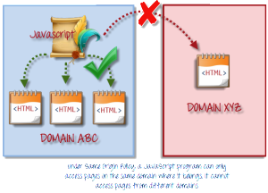


Danger
User-specific data is often included in the resulting script code, e.g., within the value of a variable.
After delivering the script to the browser, this data is immediately available to the client-side logic for further processing and presentation.

Slide 6
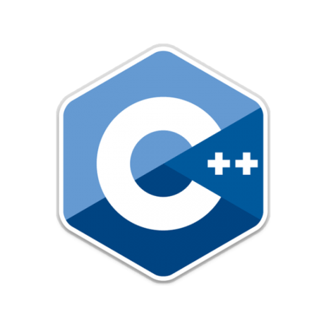

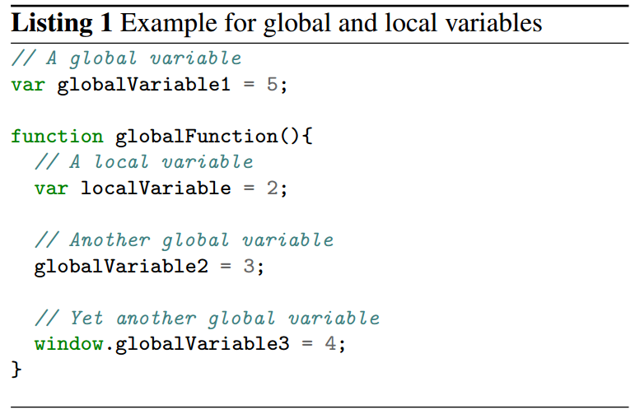
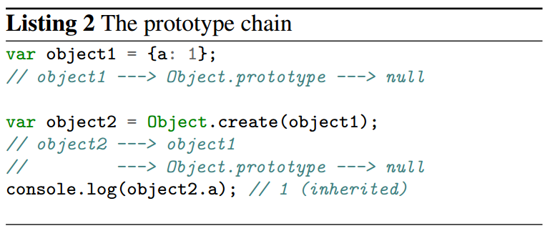
JavaScript Language Features
The JavaScript engine creates a new scope for each new function it encounters.
Only code that is defined within the same function is thus able to access such a variable residing in the local scope.
JavaScript’s inheritance is not based on classes but directly on other objects, whereas “each object has a link to another object called its prototype”.

Slide 7
Outline
Motivation
Technical Background
Cross-Domain Data Leakages
Empirical Study
Conclusion

Slide 8
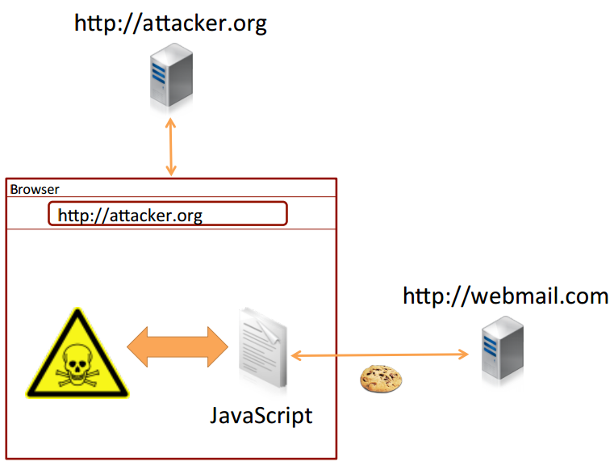

Cross-Domain Data Leakages
HTML script tags are not subject to the Same-Origin Policy
If a dynamic script exposes side effects dependent on sensitive data in the script code, the execution of such a script may leak the secret data.
Attacker Model
The attacker can simply access the value of this global variable, effectively leaking the user’s email address.

Slide 9

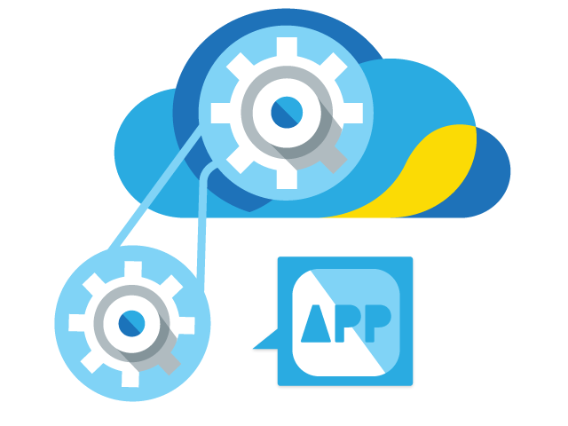

Attack Vectors: Prototype Tampering
Global Variables: whenever sensitive user data is assigned to such a global variable inside a script, an attacker can gain access to the corresponding data.
Redefinition of Global APIs: any function can be overwritten by an attacker If a dynamic script passes a security-sensitive value to such a function, the attacker may overwrite it beforehand and hence retrieve the secret value.

Slide 10

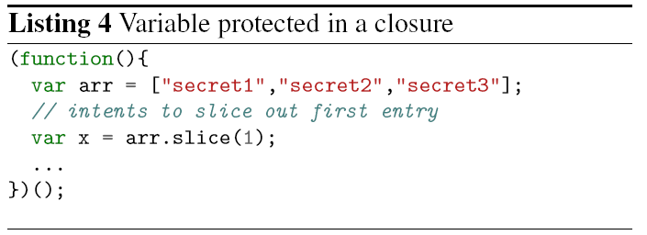
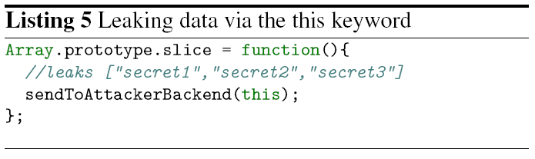
Attack Vectors: Prototype Tampering(Continue)
Variables are available in the scope in which they were defined unless the var keyword is omitted.
The script is included without any malicious intent, the programmer may assume that the call will eventually trigger invocation of the slice method for arrays.
Listing 4 Variable protected in a closure
Listing 5 Leaking data via the this keyword

Slide 11
Distinction towards CSRF
Leaking sensitive information via cross-domain script includes belongs to a larger class of Web attacks which function via creating authenticated requests in the context of an authenticated Web user.
CSRF is an attack in which an attacker generates requests to cause state-changing actions in the name of the user. Thereby the attacker is by no means able to read content from a response to a CSRF request.
Dynamic scripts are neither designed to conduct state-changing actions on the serverside nor are these scripts ever fetched via POST requests.

Slide 12
Outline
Motivation
Technical Background
Cross-Domain Data Leakages
Empirical Study
Conclusion

Slide 13
Empirical Study: Methodology
Research Questions
The general prevalence of dynamically generate scripts
Find out how common dynamic script generation is in today’s Web and how often these dynamic scripts are dependent on a user’s session state.
Investigating the exploitability and discussing potential countermeasures.
Detecting State-dependent Scripts
a Chrome browser extension:
Collecting scripts
Detecting dynamic code generation based on authentication credentials

Slide 14
Empirical Study: Methodology(Continue)
Data Set
An active user account (or a similar stateful relationship) at the tested site.
The 150 highest ranking (according to Alexa) Web pages matching the following criteria:
Account registration and login is freely available for anyone.
Available in either German, English or a Web site which can be translated using Google Translate.
Not a duplicate or localized variant of an already investigated site.

Slide 15
Prevalence of Dynamic Scripts
We gathered a total of 9,059 script files spread across 334 domains and their subdomains.
Although our data set only consists of 150 different domains, we gathered scripts from such a large number of domains due to the fact that the investigated Web sites include third-party frames pointing to, e.g., advertisement providers.
Over half of the sites—81 out of the 150 analyzed domains—utilized some form of dynamic script generation.
The usage of state-dependent dynamic scripts is widespread, namely one third of the investigated domains.

Slide 16
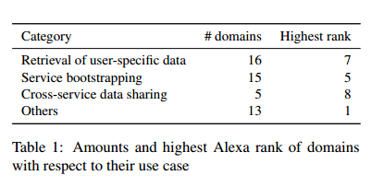
Purposes of Dynamic Scripts
Retrieval of user-specific data, such as the name, email address or preferences for the logged-in user.
Service bootstrapping, i.e., setting up variables necessary for a rich client-side application to work.
Cross-service data sharing, which was often applied to allow for single sign-on solutions across multiple services of the same provider or for tracking of users on different domains through a single tracking service.

Slide 17
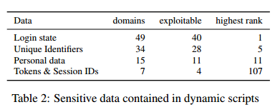
Types of Security Sensitive Data
A manual analysis of the scripts’ data that changed its value, depending on the authentication state of the script request.
Four categories of potentially security critical data:
Login state: The first type of data that could be extracted from dynamic scripts was a user’s login state to a certain application
Unique identifiers: the leakage of data that uniquely identified the user.
Personal data: we classified all those pieces of data which do not necessarily uniquely identify a user, but provide additional information on him, such as his real name, his location or his date of birth.
Tokens & Session IDs: tokens and session identifiers for an authenticated user. These tokens potentially provide an attacker with the necessary information to interact with the application in the name of the user.

Slide 18


Exploitation
Login oracles since they provide an attacker with either explicit or implicit information on whether a user is currently logged into an account on a given website or not.
Tracking Users： some pieces of data which uniquely identify a user.
The email address used to register for the corresponding service, followed by some form of user ID (such as login name or customer ID).

Slide 19


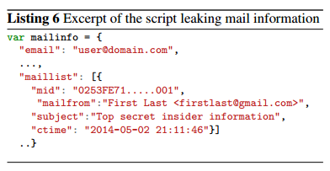
Personalized Social Engineering
Gathering information on sites a user has an account on as well as retrieving additional information can aid an attacker in a personalized attack.
Targeted advertisement：two online shopping platforms utilize a dynamic script which provides the application with the user’s wish list.
Application-Specific Attacks
Extracting Calendar Entries
Reading Email Senders and Subjects
Session Hijacking Vulnerabilities:
Circumventing CSRF Protection

Slide 20

Notification of Vulnerable Sites and Summary
Notification of Vulnerable Sites
Out of the 49 domains which are dependent on the user’s login state, 40 lack adequate protection and can therefore be used to deduce if a user is logged into a certain application.
On 28 of these domains, dynamic scripts allowed for unique identification of the current user through various means like customer IDs or email addresses.

Slide 21
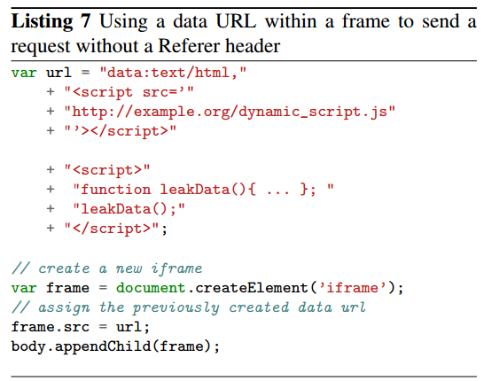
Non-exploitable Situations
The URL of the script was not guessable by an attacker
Non-exploitable
The Web site utilized referrer checking to avoid the inclusion of resources by third parties
Unguessable URLs
Referrer Checking
Many Web pages tend to misuse the Referer header containing the URL of the embedding site as a security feature.

Slide 22
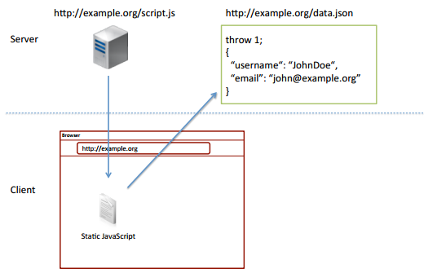
Protection Approach
The main problem: the incorporation of sensitive user data into files that are not completely protected by the Same-Origin Policy.
Script code is never generated on the fly, but always pulled from a static file.
Sensitive and dynamic data values should be kept in a separate file, which cannot be interpreted by the browser as JavaScript.

Slide 23
Conclusion
A study into the prevalence of a class of vulnerabilities dubbed Cross-Site Script Inclusion.
To investigate this class of security vulnerabilities, we developed a browser extension capable of detecting such scripts.
We proposed a secure alternative using well-known security concepts, namely the Same-Origin Policy and Cross-Origin Resource Sharing, to thwart the identified security issues.

Slide 24
Questions
What is Same-origin Policy? Does it hold for cross-domain inclusion of Web content using HTML tags?
Why the attacker can simply access the value of this global variable, effectively leaking the user’s email address?
What are the purpose of dynamic scripts?

